Slide 1
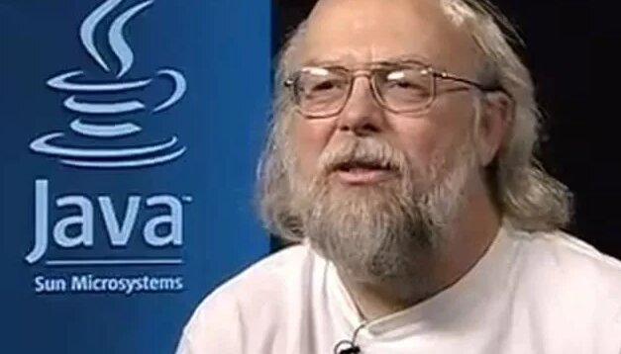
James Gosling
The father of the java language

Slide 2

From farmer to genius
James Gosling was born in 1955 in Canada, on a small farm near Calgary.
Already in his youth, he showed exceptional abilities in mathematics and
electronics. Even as a schoolboy, he independently built a temperature control system for a farm using old phone parts and other trash. He holds a Bachelor of Science degree in Computer Engineering from the University of Calgary and a doctorate from Carnegie Mellon University.

Slide 3
the birth of java
In 1984, Gosling joined Sun Microsystems, where he made his major breakthrough.
In 1991, he led the Oak project, the development of a platform for interactive television and other “smart” devices such as toasters and microwaves.
Oak was designed to solve the problem of compatibility of devices from different manufacturers using a single programming language running on different architectures.
Although the Oak project has not been widely used in interactive television due to market constraints, its concept of platform independence has proven to be extremely valuable.

Slide 4
In 1995, Oak was renamed Java and introduced to the world. It was a moment of truth that changed the industry.
The key principle of Java has become platform independence, thanks to the Java Virtual Machine (JVM). The JVM allowed Java code to run on any platform where the JVM was installed. It was a real breakthrough!
The slogan “Write Once, Run Anywhere” (WORA) has become the hallmark of the language. It was a promise that Java kept.
Java has revolutionized programming by making it easier to develop cross-platform applications. Developers no longer had to rewrite the code for each operating system. This has saved a huge amount of time and resources.
Java applets (small applications running in web browsers) have made the web more interactive and dynamic, laying the foundation for modern web applications.

Slide 5
Java is used in a wide range of applications, from mobile devices and web applications to enterprise systems and supercomputers. It is a language that permeates the entire digital world. Android, one of the most popular mobile operating systems, is based on Java (or, more precisely, on the Dalvik VM, which has a lot in common with the JVM). Billions of devices run on Java! Java has had a huge impact on the development of web technologies, making it possible to create dynamic and interactive websites. Without Java, we would still be using static web pages! Banking systems, scientific research, games – Java is everywhere.

Slide 6
Google and Liquid Robotics
In 2010, after Oracle acquired Sun Microsystems, Gosling joined Google. It was a logical step, given Google's innovative culture.
In 2011, he joined Liquid Robotics, a company engaged in the development of oceanic robots. Gosling has always been interested in environmental issues and ocean exploration, and Liquid Robotics has given him the opportunity to apply his knowledge and experience to these challenges.
At Liquid Robotics, he worked on software development for autonomous robotic platforms designed to collect data in the ocean. Imagine robots floating in the ocean and collecting information about pollution, water temperature and other parameters – this is the future that Gosling is helping to build. He was engaged in the creation of reliable and efficient software capable of operating in extreme ocean conditions.

Slide 7
Merits
Gosling is a member of the US National Academy of Engineering. This is one of the most prestigious titles an engineer can receive.
In 2002, he received The Economist Innovation Award for his contributions to technology development.
In 2015, he was awarded the title of Officer of the Order of Canada for his contribution to the development of technology. It is the highest civilian award in Canada.
He is the author of several books and numerous articles on programming that continue to inspire and educate new generations of programmers.
He is also an honorary doctor of a number of universities.

Slide 8
Why java?
Initially, the project was called “Oak”, in honor of the tree by Gosling's window. But the new name had to be memorable, simple, and unrelated to technology.
We considered “Silk”, but the choice fell on “Java", a type of coffee from the island of Java. Legend has it that the name was chosen by chance over a coffee break, symbolizing the vigor and energy of the new language.
"Java" sounded exotic and modern, attracting attention. They say that after choosing the name, the team even started drinking more Java coffee!
A cup of hot coffee has become a logo, symbolizing the energy and productivity associated with Java.

Slide 9
Java in the age of AI
Despite its maturity, Java is dynamically developing, adapting to key trends: artificial intelligence (AI), machine learning (ML) and cloud computing.
New specialized frameworks and libraries significantly simplify the development of applications using AI and ML algorithms on the Java platform.
Java remains a key language for developing enterprise applications that are actively migrating to cloud environments, ensuring reliability and scalability.
The active and large Java community is working tirelessly to improve the performance, security, and stability of the language and its ecosystem.
The Java Virtual Machine (JVM), the foundation of Java, is constantly being improved, optimizing Java code execution and supporting modern hardware architectures.
Java proficiency remains a highly sought-after skill in the labor market, opening up wide opportunities for developers in various industries.
James Gosling, as the creator of Java, continues to inspire new generations of programmers with his new.

Slide 10
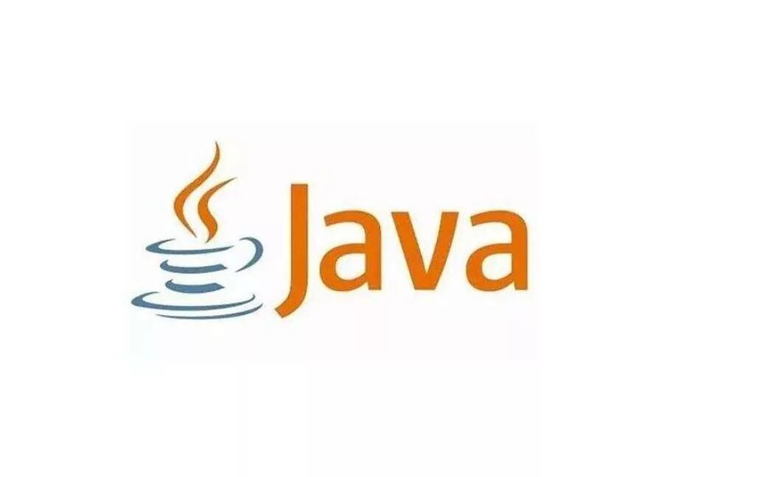
Thanks for your attention

